Slide 1
Data Analysis G1
Manufacturing Downtime
Increase productivity and reduce costs
Supervised by:
Dr. Anas Ismail
Team Members:
Ahme Hamed (21088892)
Omar Ramadan (21072762)
Ahmed Magdy (21081225)
Mohamed Hatem (21083520)
Ahmed Mahmoud (21067780)
Mohamed Abdelmoniem (21070230

Slide 2
Table of contents
02
01
04
05
03
Introduction & Agenda
Data understanding
Questions
Explain the data
The questions need to be asked for this data
What should be done?
06
Techniques
Analysis
Conclusion and Recommendations
Excel & Power BI
Dashboard and numbers

Slide 3
01
Introduction & Agenda
What should be done?

Slide 4
Data Collecting
Making questions and where to reach
Data Cleaning
Data Analysis
Dashboard and Visualizations
Finding problems
How to solve

Slide 5
02
Data understanding
Explain the data

Slide 6
Product
Batch
Factory
Downtime
Operator
Production Line

Slide 7
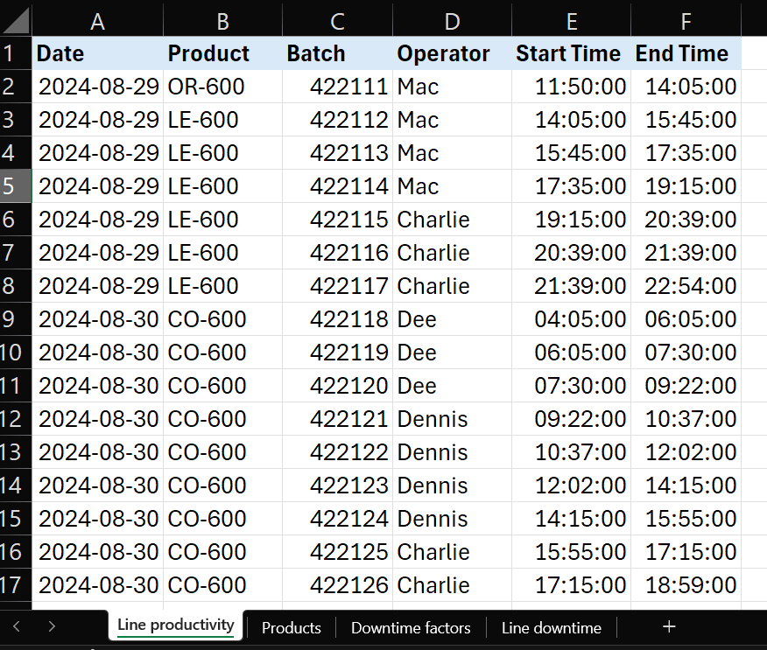
The input data
Line productivity

Slide 8
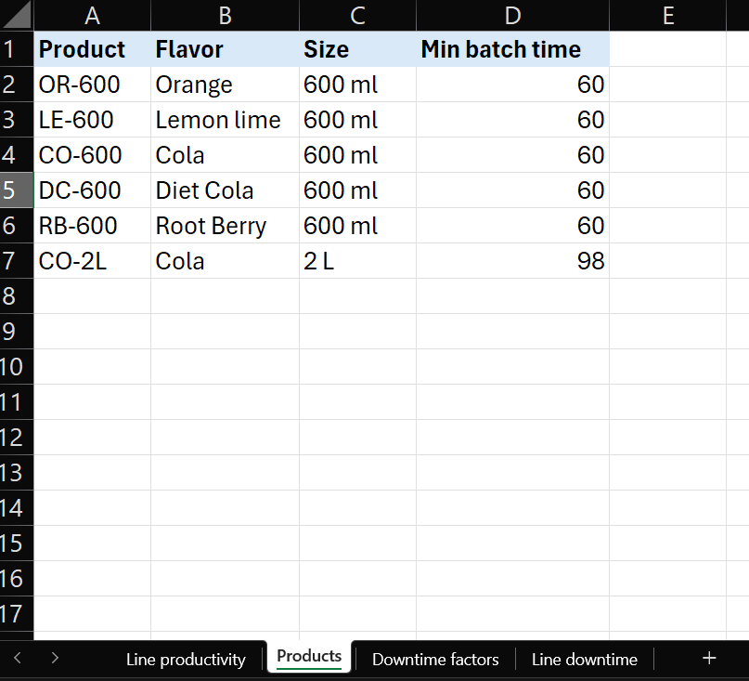
The input data
Line productivity
Products

Slide 9
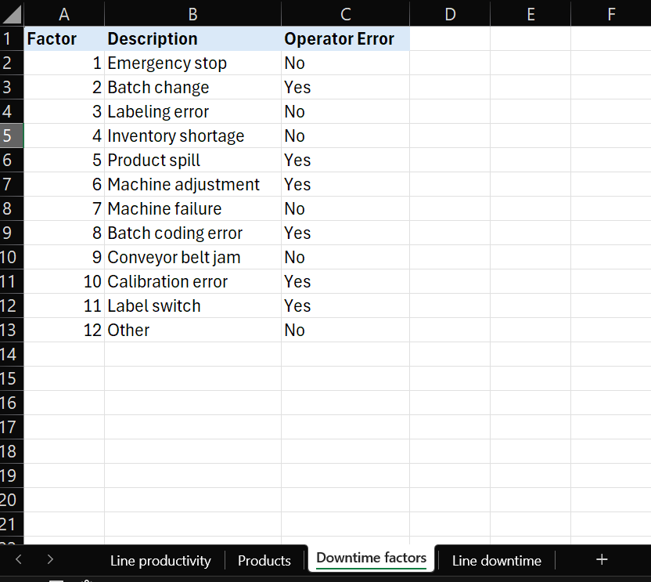
The input data
Line productivity
Products
Downtime factors

Slide 10
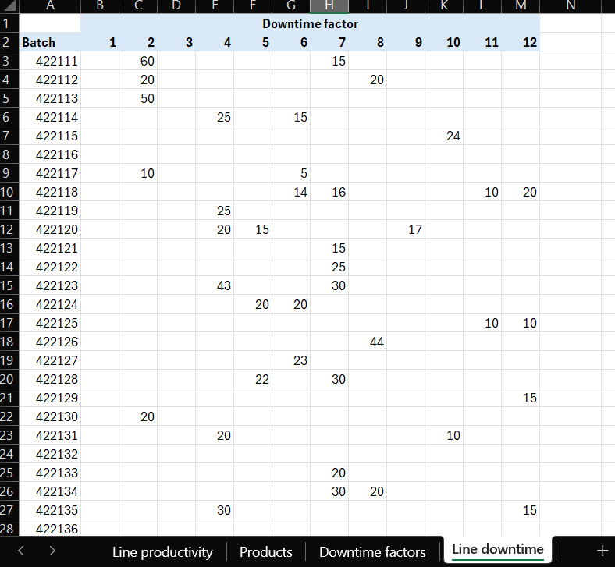
The input data
Line productivity
Products
Downtime factors
Line downtime

Slide 11
03
Questions
The questions need to be asked for this data

Slide 12
The Questions
The most and least productive operator
The highest repeated downtime failure
Production bottleneck downtime
Machine downtime vs operator downtime
Downtime by product

Slide 13
The Questions
The most productive product that makes downtime
Actual work time vs Batch work time (Operator)
Actual work time vs Batch work time (Product)
Efficiency per operator
Ranking tables per downtime cause, operator, and machine

Slide 14
04
Techniques
Excel & Power BI

Slide 15

Power BI
Widely Used & Accessible
Powerful Data Manipulation
Flexibility & Customization

Slide 16

Power BI
User-Friendly Interface
Powerful Data Visualization
Data Cleaning & Transformation
Data manipulation and modeling

Slide 17
05
Analysis
Dashboard and numbers

Slide 18


Slide 21
06
Conclusion and Recommendations

Slide 22
Need to make working instructions on how to operate the line
Make excessive operator training (especially Mac)
Total preventive maintenance plan for the line
The Machine adjustment should be done by a technician, not an operator, to ensure the process goes without a problem

Slide 23
Provide machine adjustment training to all operators
Plan with the material feeding inventory
The Machine adjustment should be done by a technician, not an operator, to ensure the process goes without a problem

Slide 24

Do you have any questions?

